Slide 1
Recognition AFTER Death?
All verses are from the NKJV unless otherwise noted.

Slide 2
This Question Asks
Will we remember those separated from us by death?
What will we recognize in heaven?
Who will we recognize in heaven?
Is the song “If We Never Meet Again This Side of Heaven” a scriptural song?
Notes:
594 Brown

Slide 3
Affirm #1
WE WILL REMEMBER THOSE WE KNEW IN THIS LIFE

Slide 4
EVIDENCE—THE MEMORY REMAINS
The soul can cry out without a mouth and remember without a brain!
From Luke 16:19-31
24 "Then he cried and said, ‘Father Abraham, have mercy on me, and send Lazarus that he may dip the tip of his finger in water and cool my tongue; for I am tormented in this flame.’
25 "But Abraham said, ‘Son, REMEMBER that in your lifetime you received your good things, and likewise Lazarus evil things; but now he is comforted and you are tormented.
HE REMEMBERED EVENTS
Notes:
The soul doesn’t need a brain to remember anymore than it needs a mouth to cry out (v. 24).

Slide 5
EVIDENCE—THE MEMORY REMAINS
From Luke 16:19-31
27 "Then he said, ‘I beg you therefore, father, that you would send him to my father’s house,
28 ‘for I have five brothers, that he may testify to them, lest they also come to this place of torment.’
HE REMEMBERED PEOPLE

Slide 6
EVIDENCE—THE MEMORY REMAINS
From 1 Samuel 28:11-19 (cf. 15:27-29)
17 "And the LORD has done for Himself AS HE SPOKE BY ME. For the LORD has torn the kingdom out of your hand and given it to your neighbor, David.
18 "Because you did not obey the voice of the LORD nor execute His fierce wrath upon Amalek, therefore the LORD has done this thing to you this day.
HE REMEMBERED MANY THINGS!
Notes:
Samuel remembered what he preached to Saul in 15:27-29; he also remembered that Saul did not obey. He remembered Amalek and the hideous crimes that he committed against the Lord’s people.

Slide 7
Affirm #2
WE WILL RECOGNIZED BIBLE SAINTS AFTER DEATH

Slide 8
EVIDENCE—RECOGNIZING BIBLE SAINTS
The rich man recognized Abraham (Lk. 16:23, 24)
Rich man and his family lived under the authority of Law of Moses (Lk. 16:29)
Paul taught that Abraham lived 430 years before the Law was given through Moses (Gal. 3:16-18)
Rich man could not have seen Abraham in his “lifetime” but recognized Abraham in Hades
Notes:
The rich man lived during a time when Moses and the prophets were in force. This proves that he did not see Abraham on earth because according to Paul, Abraham lived 430 years earlier than the giving of the Law of Moses (Gal. 3:16-18).

Slide 9
EVIDENCE—RECOGNIZING BIBLE SAINTS
The apostles recognized Moses and Elijah (Matt. 17:1-8)
Moses and Elijah “appeared to them, talking with Him” (17:3)
Peter, James and John had never seen Moses and Elijah
Moses and Elijah had never seen each other on earth
Evidently, everyone recognized everyone
Notes:
Hence I have proven the proposition from the scriptures that Bible saints are recognized by the wicked and the righteous.

Slide 10
AFFIRM #3
WE WILL RECOGNIZE EACH OTHER

Slide 11
EVIDENCE—THE ABILITY TO RECOGNIZE DECEASED ANCESTORS
THE CASE OF ABRAHAM’S DEATH (Gen. 25:7-9)
7 This is the sum of the years of Abraham’s life which he lived: one hundred and seventy-five years.
8 Then Abraham breathed his last and died in a good old age, an old man and full of years, and was gathered to his people.
9 And his sons Isaac and Ishmael buried him in the cave of Machpelah, which is before Mamre, in the field of Ephron the son of Zohar the Hittite,
SEQUENCE
Last breath
Died
Gather to his people
Buried
Notes:
The history of the soul after death is herein affirmed to continue to exist and to exist with others.

Slide 12
EVIDENCE—THE ABILITY TO RECOGNIZE DECEASED ANCESTORS
THE CASE OF ISAAC’S DEATH (Gen. 35:29)
1
2
So Isaac breathed his last and died, and was gathered to his people, being old and full of days. And his sons Esau and Jacob buried him.
SEQUENCE
Last breath
Died
Gather to his people
Buried
3
4

Slide 13
EVIDENCE—THE ABILITY TO RECOGNIZE DECEASED ANCESTORS
THE CASE OF JACOB’S DEATH (Gen. 49:33)
And when Jacob had finished commanding his sons, he drew his feet up into the bed and breathed his last, and was gathered to his people.
SEQUENCE
Last breath
Died
Gather to his people
Buried
Jacob was buried months later (50:1-13)
Notes:
Mt 22:32 ‘I am the God of Abraham, the God of Isaac, and the God of Jacob’? God is not the God of the dead, but of the living."

Slide 14
EVIDENCE—THE ABILITY TO RECOGNIZE DECEASED ANCESTORS
THE CASE OF MOSES’ DEATH (Deut 32:48-50)
48 Then the LORD spoke to Moses that very same day, saying:
49 "Go up this mountain of the Abarim, Mount Nebo, which is in the land of Moab, across from Jericho; view the land of Canaan, which I give to the children of Israel as a possession;
50 "and die on the mountain which you ascend, and be gathered to your people, just as Aaron your brother died on Mount Hor and was gathered to his people;
PATTERN
1. die
2. be gathered to your people
3. be buried
Notes:
Pronunciation: ` Abarim [ab-aw-reem‘]. But Moses was not buried where anyone could find him. His burial was a mystery to the people (Deut. 34:5, 6).

Slide 15
EVIDENCE—THE ABILITY TO RECOGNIZE CHILDREN
THE CASE OF DAVID’S SON (2 Sam. 12:15-23)
"But now he is dead; why should I fast? Can I bring him back again? I shall go to him, but he shall not return to me."
“For whatever things were written before were written for our learning, that we through the patience and comfort of the Scriptures might have hope” (Rom. 15:4)
Notes:
David anticipated what was truly meant in being gathered to his people when he anticipated joining his son one day.

Slide 16
AFFIRM #4
WE WILL RECOGNIZE GOD AND BEHOLD HIS GLORY

Slide 17
EVIDENCE—RECOGNITION OF GOD
“As for me, I will see Your face in righteousness; I shall be satisfied when I awake in Your likeness” (Ps. 17:15)
“Behold, He is coming with clouds, and every eye will see Him, even they who pierced Him. And all the tribes of the earth will mourn because of Him. Even so, Amen” (Rev. 1:7)

Slide 18
EVIDENCE—RECOGNITION OF GOD
“Beloved, now we are children of God; and it has not yet been revealed what we shall be, but we know that when He is revealed, we shall be like Him, for we shall see Him as He is” (1 Jn. 3:2)
“They shall see His face, and His name shall be on their foreheads” (Rev. 22:4)
“Father, I desire that they also whom You gave Me may be with Me where I am, that they may behold My glory which You have given Me; for You loved Me before the foundation of the world” (Jn. 17:24)

Slide 19
Some Wonder
What about the recognizing of loved ones lost?
The rich man did not want his family to come to the place of torment (Lk. 16:28)
If his brothers were saved later, would they be sad that he was not in heaven?
Would he want his family to not pursue and obey the course of truth simply because he squander his chance?

Slide 20
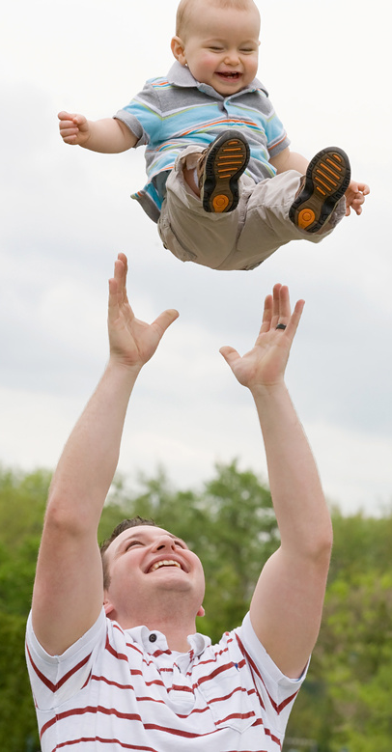
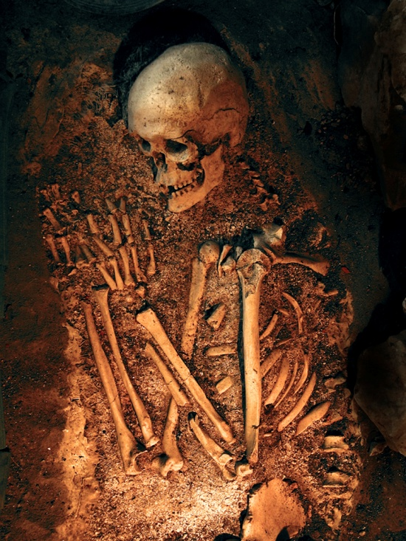
The Reality of Life After Death:
Should make parents want to tow the line of righteousness
Should make parents place their number one priority upon the salvation of their children (Mal. 2:15)
Should make us always have a tender heart that presses us to want to know and do the will of the Lord

Slide 21
Concluding Facts
We will recognize people in heaven
If we miss heaven, we are the biggest losers of all
We have missed all that really matters which we must find (1Thess. 5:9, 10)
It will be an amazing experience to see the face of God
Our bodies will be changed (1 Cor. 15:42-54)
Our relationships will be changed (Mk. 12:25)
Our emotional state will be comforted (Rev. 21:4)
The most important question of this study is not whether we will recognize God, Bible characters and family members, but will God recognize us on judgment day?

Slide 22
Luke 13 “I DO NOT KNOW YOU!”
23 Then one said to Him, "Lord, are there few who are saved?" And He said to them,
24 "Strive to enter through the narrow gate, for many, I say to you, will seek to enter and will not be able.
25 "When once the Master of the house has risen up and shut the door, and you begin to stand outside and knock at the door, saying, ‘Lord, Lord, open for us,’ and He will answer and say to you, ‘I DO NOT KNOW YOU, WHERE YOU ARE FROM,’
26 "then you will begin to say, ‘We ate and drank in Your presence, and You taught in our streets.’
27 "But He will say, ‘I TELL YOU I DO NOT KNOW YOU, WHERE YOU ARE FROM. DEPART FROM ME, ALL YOU WORKERS OF INIQUITY.’
28 "There will be weeping and gnashing of teeth, when you see Abraham and Isaac and Jacob and all the prophets in the kingdom of God, and yourselves thrust out.

