Slide 1
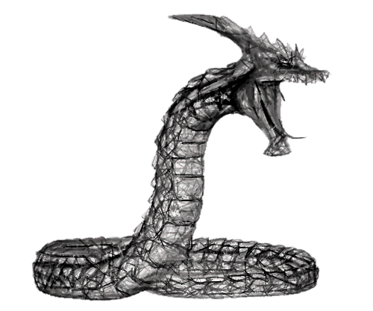
Part 3

Slide 2
The serpent’s
identity
craftiness
questioning

Slide 3
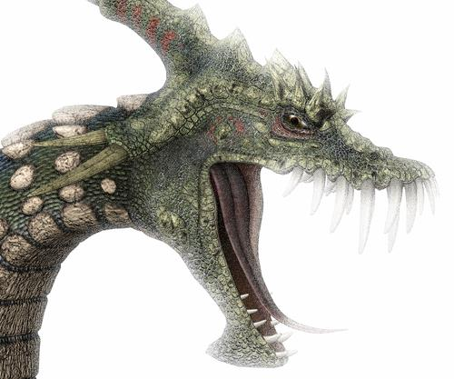
contradicts GOD’S
WORD
GENESIS 3:2-4
“And the woman said to the serpent, ‘We may eat the fruit of the trees of the garden; but of the fruit of the tree which is in the midst of the garden, God has said, “You shall not eat it, nor shall you touch it, lest you die.”’ Then the serpent said to the woman, ‘You will not surely die.’”

Slide 4
“NOTS” in the Devil’s
ale
You will
NOT surely die!”
Marriage is not between one man and one woman!
Elders must not have faithful children!
You need not assemble with the saints every service!
There is not one church!

Slide 5
One Exclusive Church?
Ephesians 1:22, 23, “…head over all things to the church, which is His body, the fullness of Him who fills all in all.”
“And He is the head of the body, the church…” (Col. 1:18)
Church is the body → Body is the church

Slide 6
Which One Is Not Exclusive?
CHURCH is the BODY → BODY is the CHURCH
Ephesians 4:4-6:
4 THERE IS ONE BODY and one Spirit, just as you were called in one hope of your calling;
5 one Lord, one faith, one baptism;
6 one God and Father of all, who is above all, and through all, and in you all.
Ephesians 5:23, “For the husband is head of the wife, as also Christ is head of the church; and He is the Savior of the body.”

Slide 7
“NOTS” in the Devil’s
ale
You will
NOT surely die!”
You need not have authority for everything you say and do in matters of religion!
Command/Statement (Matt. 28:19, 20)
Approved Example (1 Pet. 2:21, 2 Thess. 3:9)
Necessary Inference (Jn. 3:2)

Slide 8
Jesus Expected His Listeners To Reach Necessary Conclusions Based On What Was Known!
Luke 12:54-57
CLOUD OUT OF WEST?
SOUTH WIND?
?
A SHOWER IS COMING
HOT WEATHER
?

Slide 9
Jesus Defeated His Opponents With Necessary Inferences
Matthew 22:31, 32; 41-46
“I AM”
DAVID CALLS HIM “LORD”
ABRAHAM IS LIVING
CHRIST MORE THAN DAVID’S SON

