Slide 1
Theme Of The Bible
“The Redemption Of Man From Sin”
Section V: Genesis 6, 7
(Judgment of Water)
All verses from the NKJV unless noted.

Slide 2
Questions
What was God sorry for?
What did Noah find in the eyes of the Lord?
How large was the ark?
How were the animals saved?

Slide 3
Sin
Is recurrent (6:5)
Is global (6:11, 12)
Is destructive (6:13)

Slide 4
Corruption
Corruption of the flesh (6:1-4)
Corruption of the mind (6:5)
Corruption of society (6:11, 12)
Notes:
“Men” (v. 1) “of men” (v. 2)
“Sons of God?” Either lineage of Seth or angels (Jude 6, 7).
Daughters (v. 1) and “daughters of men” (v. 2): females
Polygamy (v. 2)
Giant “nephilim” descendants (v. 4; cf. Num. 13:33)

Slide 5
Living Right Within Corrupted Culture
Genesis 6:8-12
Noah’s world was filled with corruption, violence and all forms of wickedness, YET he found grace
God had sorrow toward man’s creation
God had favor toward Noah’s life
“Walked with God”
“GRACE” → “FAITH” (Eph. 2:8)
Noah found grace (Gen. 6:6)
Noah moved by faith (Gen. 6:9, 22; Heb. 11:7)

Slide 6
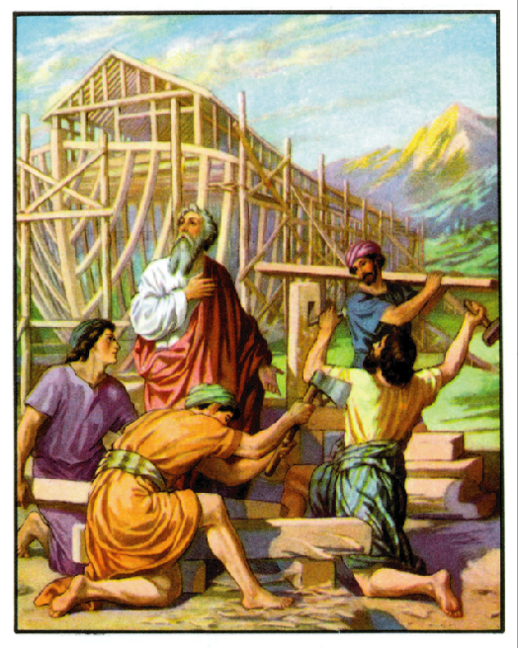
The Ark (6:13-22)
A vessel of mercy (1 Pet. 3:20)
A vessel for salvation (Heb. 11:7)
Was built to save man and beast
Was large enough to save more than Noah’s family
A vessel that proclaimed condemnation (Heb. 11:7)
A vessel that teaches authority
Principle of holding to pattern (1 Chron. 15:2, 13; cf. 13:10)

Slide 7
The NT Ark: The Church
One ark
One church
(Gen. 6:14; Matt. 16:18; Eph. 1:22, 23; 4:4; Acts 2:47)
One Material
Living stones
(Gen. 6:4; 1 Pet. 2:5)
One Covering
Blood of One
(Gen. 6:14; Rev. 1:5; Eph. 2:13; 1 Pet. 1:18, 19; 1 Jn. 1:7)
One Window
One Gospel
(Gen. 6:16; Ps. 119:105; 2 Cor. 4:4; Eph. 4:5; Gal. 1:6-9)
One Door
One Entrance
(Gen. 6:16; Jn. 10:1, 9; 14:6)

Slide 8
The Flood
A measure of judgment (Gen. 6:17; 7:17-24)
Destroyed all land creatures outside the ark
Condemned all men outside the ark as unrighteous (7:1)
A measure of salvation (2 Pet. 2:5; 1 Pet. 3:20, 21)
The waters took Noah out of a world of corruption and into a new world
Baptism takes us out of condemnation and into salvation…hence we look for a new heavens and new earth of righteousness (2 Pet. 3:13)

Slide 9
The History of the Flood
Genesis is real history (Gen. 2:4)
Endorsed by the prophets (Is. 54:9; Ezek. 14:14, 20)
Endorsed by Jesus and apostles (Matt. 24:36-39; Lk. 17:26, 27; Heb. 11:7; 1 Pet. 3:20; 2 Pet. 3:5, 6; Heb. 11:7)

Slide 10
Why The Flood Was Global
The command to build an ark versus relocate to another part of the world
The size of the ark built (volume equal to 522 railroad cars)
The purpose of the ark being built (necessity to preserve every kind of land creature (Gen. 6:19, 20)
The height of the waters on the earth
mountains covered by 15 cubits, Gen. 7:19, 20, cf. 6:15

Slide 11
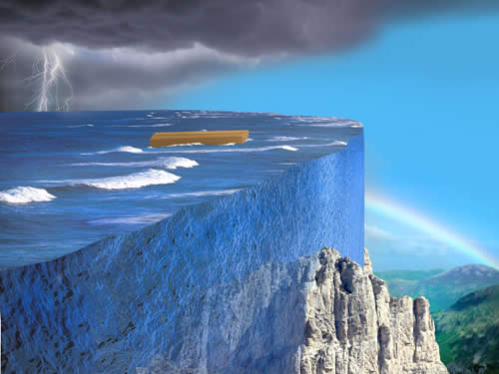
For Some Good Material On The Flood Visit This Page
http://www.answersingenesis.org/articles/nab/really-a-flood-and-ark#fnMark_1_13_1

