Slide 1
Part 1

Slide 2
Man’s Root Problem
SIN
Our
SIN
Genesis 3-11
Isaiah 53:5
Galatians 1:4

Slide 3
GENESIS → JESUS
ALL MADE
ALIVE
ALL DIE
First
Man
Adam
Last
Adam
1 Corinthians 15:21, 22
1 Corinthians 15:45

Slide 4
2 Corinthians 2:11
“Lest Satan should take advantage of us; for we are not ignorant of his devices.”

Slide 5
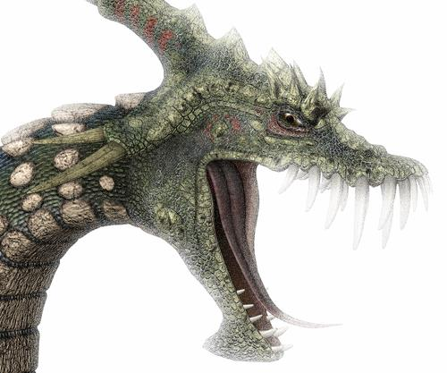
clever and crafty
cunning
GENESIS 3:1
“Now the serpent was more cunning than any beast of the field which the LORD God had made. And he said to the woman, ‘Has God indeed said, “You shall not eat of every tree of the garden”?’”
2 Corinthians 11:3 | Genesis 27:15, 16 | Joshua 9:3-6 | Luke 20:20-26| Ephesians 4:14

Slide 6
Safeguards Against Satan’s Cleverness
Speak as the oracles of God
1 Peter 4:11
Do not think beyond what is written
1 Corinthians 4:6
Mind the harmony of Scripture
Matthew 4:5-7

Slide 7
Safeguards Against Satan’s Cleverness
Measure all things by what is written
1 Thessalonians 5:21; Acts 17:11
Do not let pride or personal preference sour the truth
Saul, Jeroboam, Uzziah, etc.

